Slide 1
HL7 WGM+ Atlanta, GA Sep 2024
HL7 FHIR 101
Richard Ettema

Slide 2





Who am I?
Name: Richard Ettema
Position:
Lead Architect, Touchstone, AEGIS.net, Inc.
HL7® FHIR® Proficient
HL7® Certified Educator (CE) - FHIR®
Background:
20+ years leading HIT development/implementation efforts
11+ years contributing to the HL7® FHIR® specification (focus on testing)
Contributor to the HL7® FHIR® IG Authoring Tools
Author of the AEGIS WildFHIR Enterprise and Community public test servers and clients

Slide 3
This presentation
Can be downloaded here:
https://github.com/FHIR/documents/blob/master/presentations/2024-09%20Tutorials/2024SepHL7_FHIR_101_Richard_Ettema.pptx
Is licensed for use under Creative Commons, specifically
Creative Commons Attribution 3.0 Unported License
(Do with it as you wish, so long as you give credit)
Is based on the official FHIR R5 specification

Slide 4
Acknowledgements
Grahame Grieve
Lloyd McKenzie
Ewout Kramer
David Hay
Brett Marquard
Josh Mandel
Rik Smithes
Daniel Bach
et al…

Slide 5
Learning Objectives
Understand how did we get here?
Become familiar with the FHIR specification
The learning objective is simple – at the end of this session, you will have the tools to navigate and understand the FHIR specification and continue your FHIR journey.

Slide 6


Slide 7
How did we get here?
It’s important to understand that FHIR did not emerge out of thin air.
Understanding and knowing FHIR first starts with the history of what came before.

Slide 8
How did we get here?
FHIR is built on existing web-based technologies

Slide 9
History of Web-based Technologies
REST formalized
REST (Representational State Transfer) is formalized by Roy Fielding in his doctoral dissertation entitled ‘Architectural Styles and and the Design of Network-based Software Architecture.’
XML development begins
XML (Extensible Markup Language) development begins, providing a flexible way to create common information formats.
JSON gains popularity
JSON (JavaScript Object Notation) begins to gain in popularity as a lightweight data format.
1999
2000
2012
1996
2000
2001
TLS formalized
RFC 2246 is published, specifying TLS (Transport Layer Security) was the successor to the SSL (Secure Sockets Layer) protocol.
HTTPS formalized
RFC 2818 specifies how to use HTTP in conjunction with the TLS (Transport Layer Security) protocol, which was the successor to SSL (Secure Sockets Layer).
OAuth2 is released
The OAuth 2.0 specification is released in October 2012 as RFC 6749 and RFC 6750. OAuth 2.0, or ‘Open Authorization’ is a standard that allows applications on websites to access resources hosted by other web apps on behalf of a user.

Slide 10
How did we get here?
FHIR is built on existing healthcare standards

Slide 11
History and evolution of HL7 standards
HL7 v3
The normative version of HL7 v3 is published. A significant effort using a formal methodology and a Reference Information Model (RIM) to ensure consistency and precision in the exchange of health information.
HL7 FHIR DSTU 1
FHIR DSTU (Draft Standard for Trial Use) is introduced by HL7, aiming to simplify healthcare data exchange using modern web technologies and standards.
HL7 is born
HL7 is founded as a non-profit organization in the United States.
1994
2005
2018
1987
2005
2014
HL7 v2.2
This version of v2 gains significant adoption in the healthcare industry for its message-based communication standards.
HL7 CDA 2.0
Clinical Document Architecture (CDA) 2.0 is released. An XML-based standard for the specification, exchange and management of clinical documents.
HL7 FHIR R4
The first normative version of FHIR, meaning parts of the standard are now considered stable and unlikely to change.

Slide 12
HL7 v2 (Some technical stuff)
MSH|^~\&|SendingApp|Some Hospital|ReceivingApp|ReceivingFac|202405191234||ADT^A01|MSG00002|P|2.5
EVN|A01|202405191234
PID|1||123456^^^Some Hospital^MR||Oliver^Ben^||20200502|M|||123 Main St^^Toronto^ON^M5G 1X8||(123)456-7890|||S||123456789|987654321
NK1|1|Oliver^Jane|MTH|456 Other St^^Toronto^ON^M5G 2X9||(987)654-3210
PV1|1|I|W^389^1^A^^^Some Hospital||||12345^Malcolmson^Caroline^^^Dr.|||||||||||A0 Z01|CustomField1^CustomValue1|CustomField2^CustomValue2
Pipe delimited, with “|” serving as the primary delimiter
However, it doesn’t always have to be a pipe “|”
Could be configured as a semicolon “;” for example
Message Type – “ADT^A01” (Admission Discharge Transfer ^ Admitted)
Segments – MSH, EVN, PID, NK1, PV1, Z01
Component and Sub-component delimiters for hierarchy – “^”, “&”, “~”, “\”

Slide 13
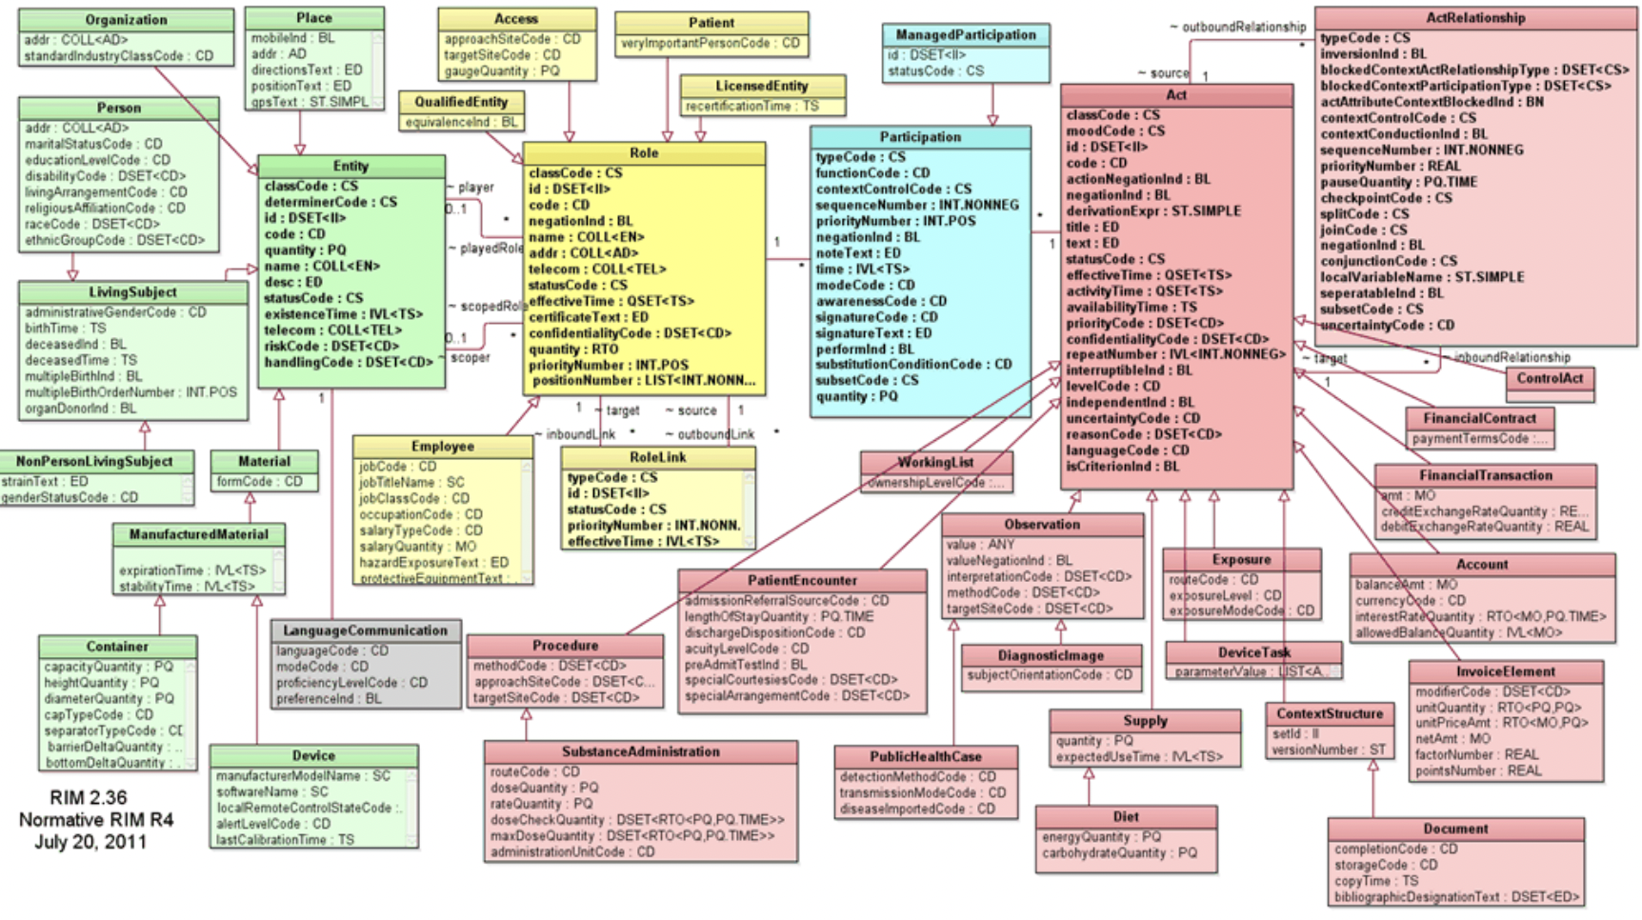
HL7 RIM (Some more technical stuff)

Slide 14
HL7 v3 (And, some more…)
<PRPA_IN201305UV02 xmlns="urn:hl7-org:v3" ITSVersion="XML_1.0">
<id root="1.2.3.4"/>
<creationTime value="20230911143411"/>
<receiver typeCode="RCV">…</receiver>
<sender typeCode="SND">…</sender>
<controlActProcess classCode="CACT" moodCode="EVN">
<code code="PRPA_TE201305UV02" codeSystem="2.16.840.1.113883.1.6"/>
<queryByParameter>
<parameterList>
<livingSubjectId>
<value extension="08242eb8-dd47-4298-8d2f-25d60114f137" root="1.1.1.2.2"/>
<semanticsText>LivingSubject.id</semanticsText>
</livingSubjectId>
</parameterList>
</queryByParameter>
</controlActProcess>
</PRPA_IN201305UV02>
Patient Demographic Query (PDQ)

Slide 15
HL7 CDA (Last one…)
<ClinicalDocument xmlns:xsi="http://www.w3.org/2001/XMLSchema-instance" xmlns="urn:hl7-org:v3">
<realmCode code="US"/>
<typeId root="2.16.840.1.113883.1.3" extension="POCD_HD000040"/>
<!-- US General Header Template -->
<templateId root="2.16.840.1.113883.10.20.22.1.1" extension="2014-06-09"/>
<!-- Discharge Summary Template -->
<templateId root="2.16.840.1.113883.10.20.22.1.8" extension="2014-06-09"/>
<id extension="TT988" root="2.16.840.1.113883.19.5.99999.1"/>
<code codeSystem="2.16.840.1.113883.6.1" codeSystemName="LOINC" code="18842-5" displayName="Discharge summary"/>
<title>Community Health and Hospitals: Discharge Summary</title>
<effectiveTime value="201409171904-0500"/>
<recordTarget>
<patientRole>
<patient>...</patient>
<providerOrganization>...</providerOrganization>
</patientRole>
</recordTarget>
...
Discharge Summary Report

Slide 16

Questions

Slide 17
FHIR – Let’s Start

Slide 18
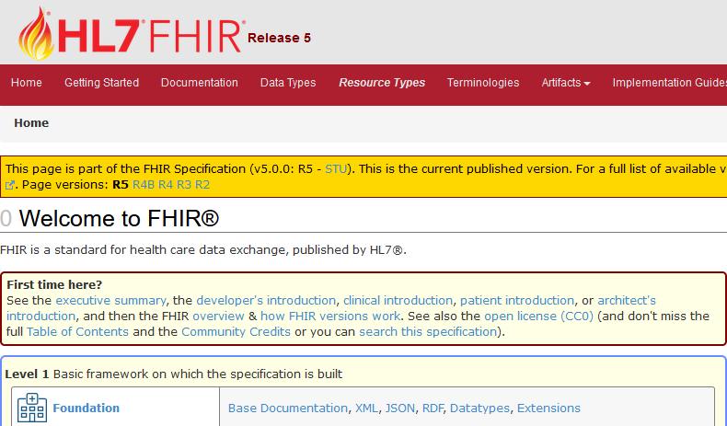
Fast Healthcare Interoperability Resources

Slide 19
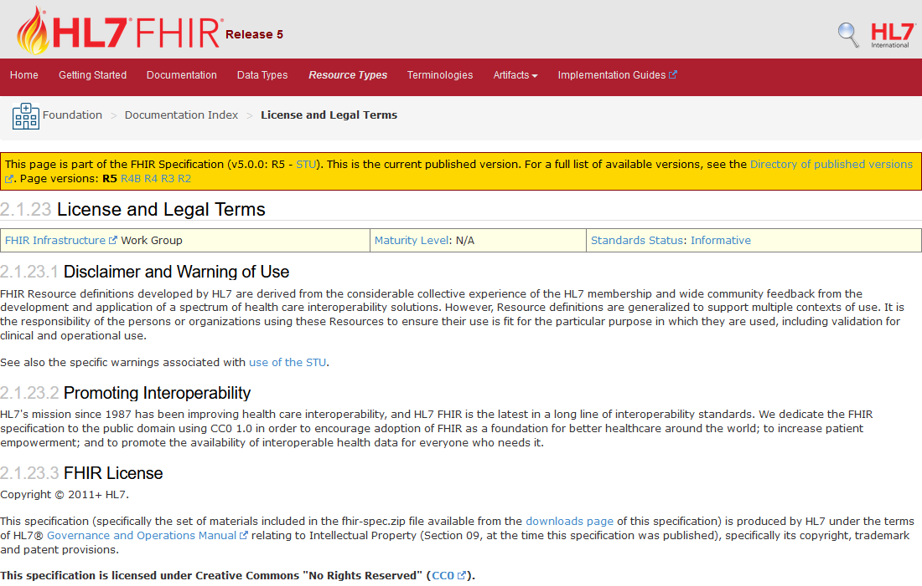
FHIR License & Terms of Use
Creative Commons "No Rights Reserved" (CC0)
FHIR is © and ® HL7. The right to maintain FHIR remains vested in HL7
HL7 does protect the "FHIR" trademark and logo
https://hl7.org/fhir/license.html

Slide 20
What is FHIR?
The latest HL7 standard for exchanging electronic healthcare information
Defines a simplified approach to Health IT implementation w/o sacrificing information integrity
Defines “Resource” as the basic building block of all exchangeable content

Slide 21
It’s all about the Resources…
Location
Related
Person
Patient
Diagnostic
Report
Practitioner

Slide 22
A FHIR Resource
Is an individual unit of exchange that represents a discrete piece of health data
mapped to formal definitions; i.e. the RIM (Reference Information Model)
can be represented in multiple formats: JSON, XML, Turtle (Terse RDF Triple)
Has native Support for Extensions (additional data)
Local, Regional, Country specific data requirements that anyone can use
Published and Managed as part of the specification
Supports Human-Readable Narrative
XHTML - manually defined and/or generated from the contents

Slide 23
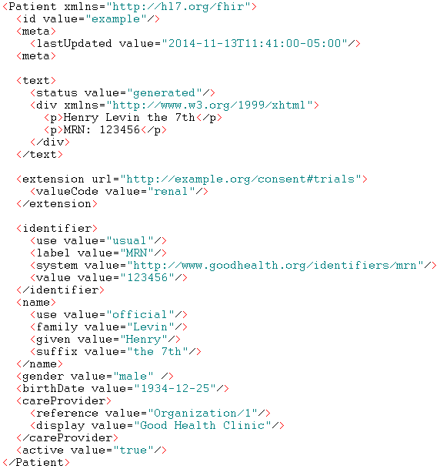
Resource Type
Resource Id
FHIR Identity/Metadata
Human Readable Summary
Extension with reference to its definition
Standard Data Content:
MRN
Name
Gender
Date of Birth
Care Provider

Slide 24
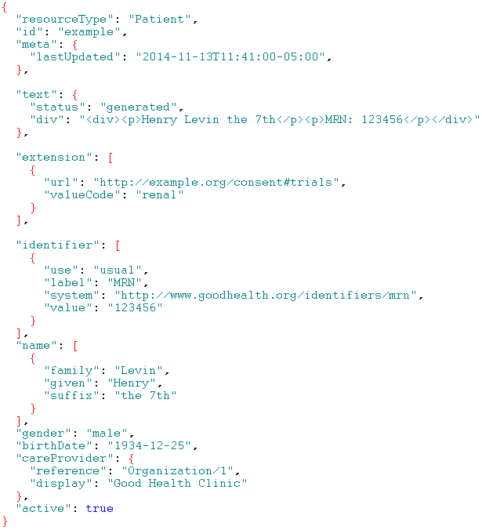
Resource Type
Resource Id
FHIR Identity/Metadata
Human Readable Summary
Extension with reference to its definition
Standard Data Content:
MRN
Name
Gender
Date of Birth
Care Provider

Slide 25
A Resource’s Id Attribute
id – identifies a resource on a (REST) server
is meta data (ALL resources have it)
will change between servers
https://server.org/fhir/Patient/123
Note: This URL resolves to the current version of the resource
resource type
Base URL endpoint
id

Slide 26
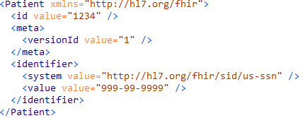
Versus a Resource’s Identifier Attribute
identifier
is a business identifier (NOT in all resources)
is an attribute within the standard data content

Slide 27
What Types of Resources?
Administrative
Patient, Practitioner, Organization, Group, Location …
Clinical Concepts
AllergyIntolerance, Condition, Observation, Medication …
Quality Reporting / Terminology / Testing
Questionnaire, Measure, ValueSet, TestPlan, TestScript …
Infrastructure / Conformance
CapabilityStatement, StructureDefinition …
FHIR R5 has
157 Resource Types

Slide 28
CapabilityStatement
A resource for documenting the capabilities of a FHIR client and server
A client should examine the CapabilityStatement of a server
May be used as the basis for conformance testing
A “FHIR Conformant” system MUST publish a CapabilityStatement
http://hl7.org/fhir/http.html#capabilities

Slide 29
StructureDefinition
A resource that describes a structured set of data element definitions and their associated rules of usage
Describes the content defined in the specification
Describes and constrains (Profiles) how these structures are utilized in implementations
Published to and shared via registries (Implementation Guides)

Slide 30
Paradigms
REST
Documents
Messages
Services
FHIR supports four interoperability exchange paradigms

Slide 31
REST
REST
Simple, out-of-the-box interoperability
Leverages HTTP: GET, POST, etc.
Pre-defined operations
Create, Read, Update, Delete
Also: History, Read Version, Search, Conditional Updates, Validate, Capabilities, Batch & Transaction
Works best where control resides on the client side and a trust relationship exists

Slide 32
Documents
Documents
Similar to CDA
Collection of resources bound together
Root is a “Composition” resource
Just like CDA header
Sent and received as a Bundle (FHIR Resource)
Single context
Can be signed and authenticated

Slide 33
Messages
Messages
Similar to V2 and V3 messaging
Also a collection of resources in a Bundle (FHIR Resource)
Root is a “MessageHeader” resource
Defines request/response behavior for complex payloads
Event-driven
e.g. Submit lab order, Link patients
Synchronous default behavior; can be asynchronous

Slide 34
Service Oriented Architecture (SOA)
Services
Combination of previous paradigms
(based on SOA principles)
Simple to complex multi-step workflows
Each step processes individual resources or collections
(Bundle, contained resources or other formats)
Uses HTTP protocol and/or others
Only constraint is that you’re passing around FHIR resources in some way, shape, manner or form

Slide 35

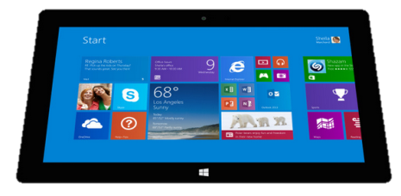
Regardless of paradigm the content is FHIR
Receive a lab result in a message…
FHIR Enabled System
FHIR Message
FHIR Document
FHIR REST
Lab System
National
Exchange
…Package it in a discharge summary document

Slide 36
Bundles – Resources in Resources
Used “to gather a collection of resources into a single instance with containing context”
“is a collection of resources [where each resource] can have an independent existence”
RESTful operations: search, history
Message exchange
Documents
Batch/Transactions
Subscriptions

Slide 37
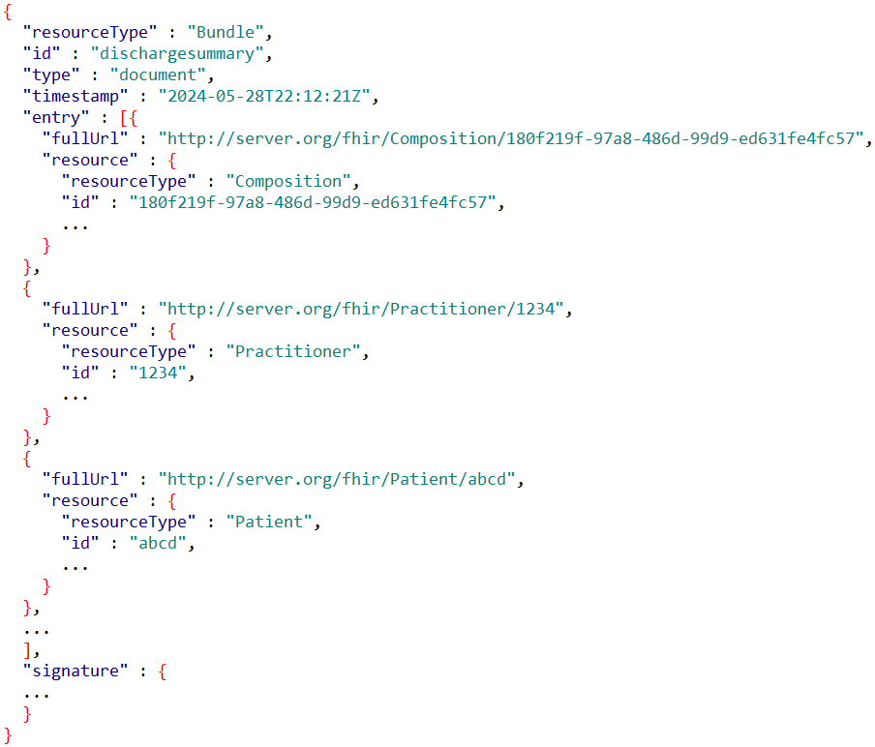
Anatomy of a Document Bundle
Bundle type
1st Bundle entry
Next Bundle entries
Optional signature

Slide 38

Pediatric Immunization Scenario
A mother takes her child to a Pediatric Office. The pediatrician needs to determine what vaccination shot(s) are due for the child.
Questions: What FHIR resource types will be used to:
record this visit and,
forecast the shot(s) that are due?

Slide 39
Answers
Recording the visit
Patient, RelatedPerson
Practitioner
Organization
Location
Encounter
Observation
Condition
Forecasting the shots
Patient
Immunization
ImmunizationRecommendation
Let’s see how this would work…

Slide 40
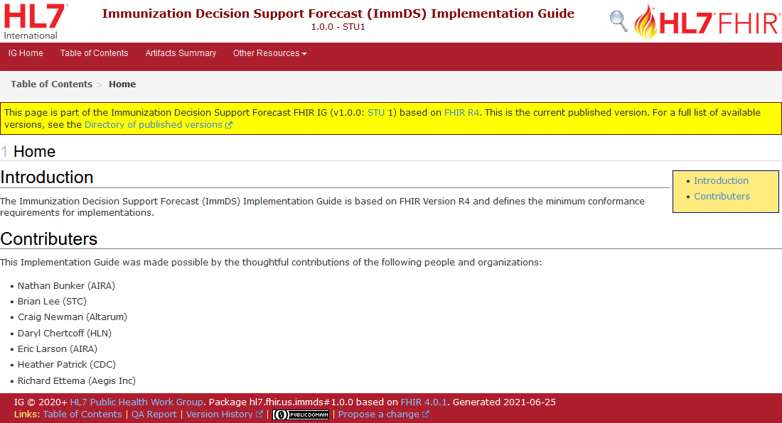

Slide 41
Immunization Forecast Workflow
http://hl7.org/fhir/us/immds
Immunization Forecast Service
Forecast Request
(Patient & Immunization(s))
Pediatric Office
3
Forecast Response (Recommendations)
2
1

Slide 42
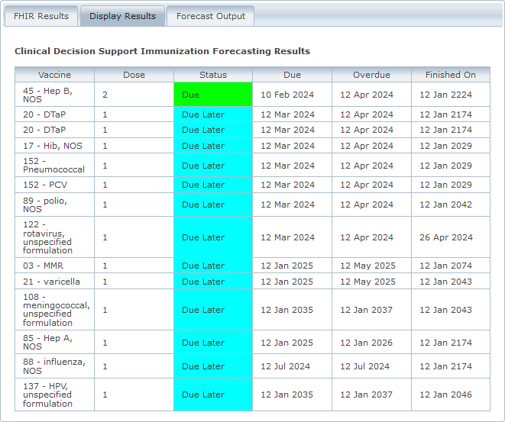
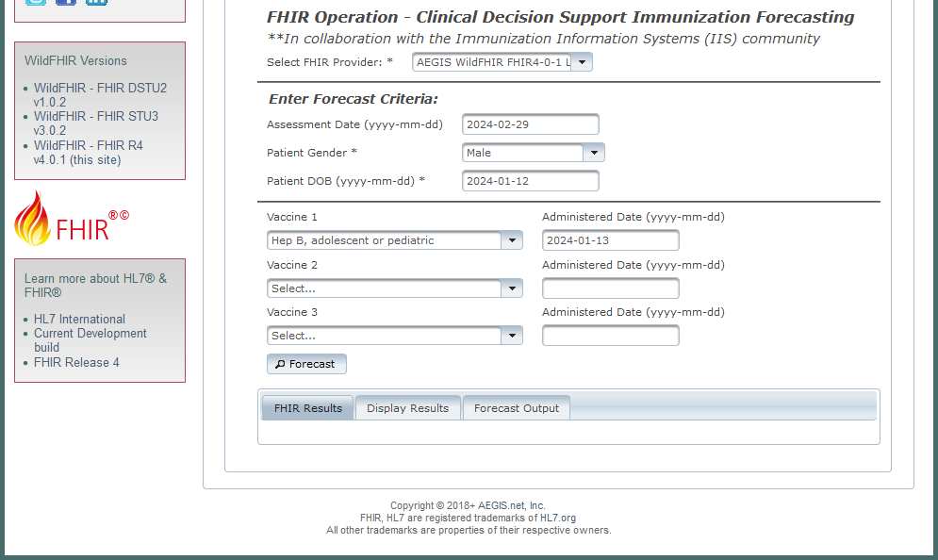
Demo
http://wildfhir4.aegis.net/fhir4-0-1-gui/index.jsf

Slide 43
Questions

Slide 44
Let’s Explore the Spec
http://hl7.org/fhir

Slide 45
FHIR Timeline
First Draft
“RfH”
DSTU
1.0
DSTU
2.0
STU
3.0
R4
1st Norm
Content
R4B
R5
R6
More Norm
Content
. . .
2011
…
2014
2015
…
2017
…
2019
…
2022
2023
…
2025

Slide 46
Closing Thought…
The FHIR development team has striven to ensure that the FHIR specification meets the 5-5-5 rule:
5 seconds to find the specification on the web
5 minutes to understand what it is
5 hours to have some working code
- Grahame Grieve, FHIR Product Director (Father of FHIR)
But, healthcare application developers should be aware of the final “-5” rule:
5 years to understand healthcare application development

Slide 47
HL7® FHIR® Resources
The specification: http://hl7.org/fhir
Publication History: http://hl7.org/fhir/directory.html
HL7® Confluence: https://confluence.hl7.org
Implementation Guides: http://hl7.org/fhir/implementationguide.html
Registry: http://www.fhir.org/guides/registry
FHIR® Zulip Chat: https://chat.fhir.org

Slide 48
Contact
You can find / reach me here:
Via Whova App – Speaker’s Gallery
Email: richard.ettema@aegis.net
LinkedIn: richard-ettema
X (formerly known as Twitter): @techknowman

Slide 49


